Slide 1
Peer Support Throughout the Lifespan
By: Laura Callen
YPA, MA: Human Services

Slide 2
Who am I?
Laura Callen
I am 26, a certified YPA and currently working on my Certified Peer Specialist and CRPA credentials.
I identify as a peer, a wife, a fur-mom and so much more!
I was able to utilize my lived expertise to earn my Masters in Human Services to help others in my community live their best life
Notes:
For employment I currently am the Director of Peer Workforce Development at Hands Across Long Island. Here I focus on coordinating our Certified Peer Specialist internship which aims to bridge the gap between the NYCPS courses and employment. We provide co-supervision between the host site, supervision for the interns we accept and provide classroom based education to further their workplace readiness as a peer provider.

Slide 3
Icebreaker
At what age do you think self- advocacy starts?
What does peer support mean to you?
Have you noticed any changes in the way you perform advocacy throughout your career or life?

Slide 4
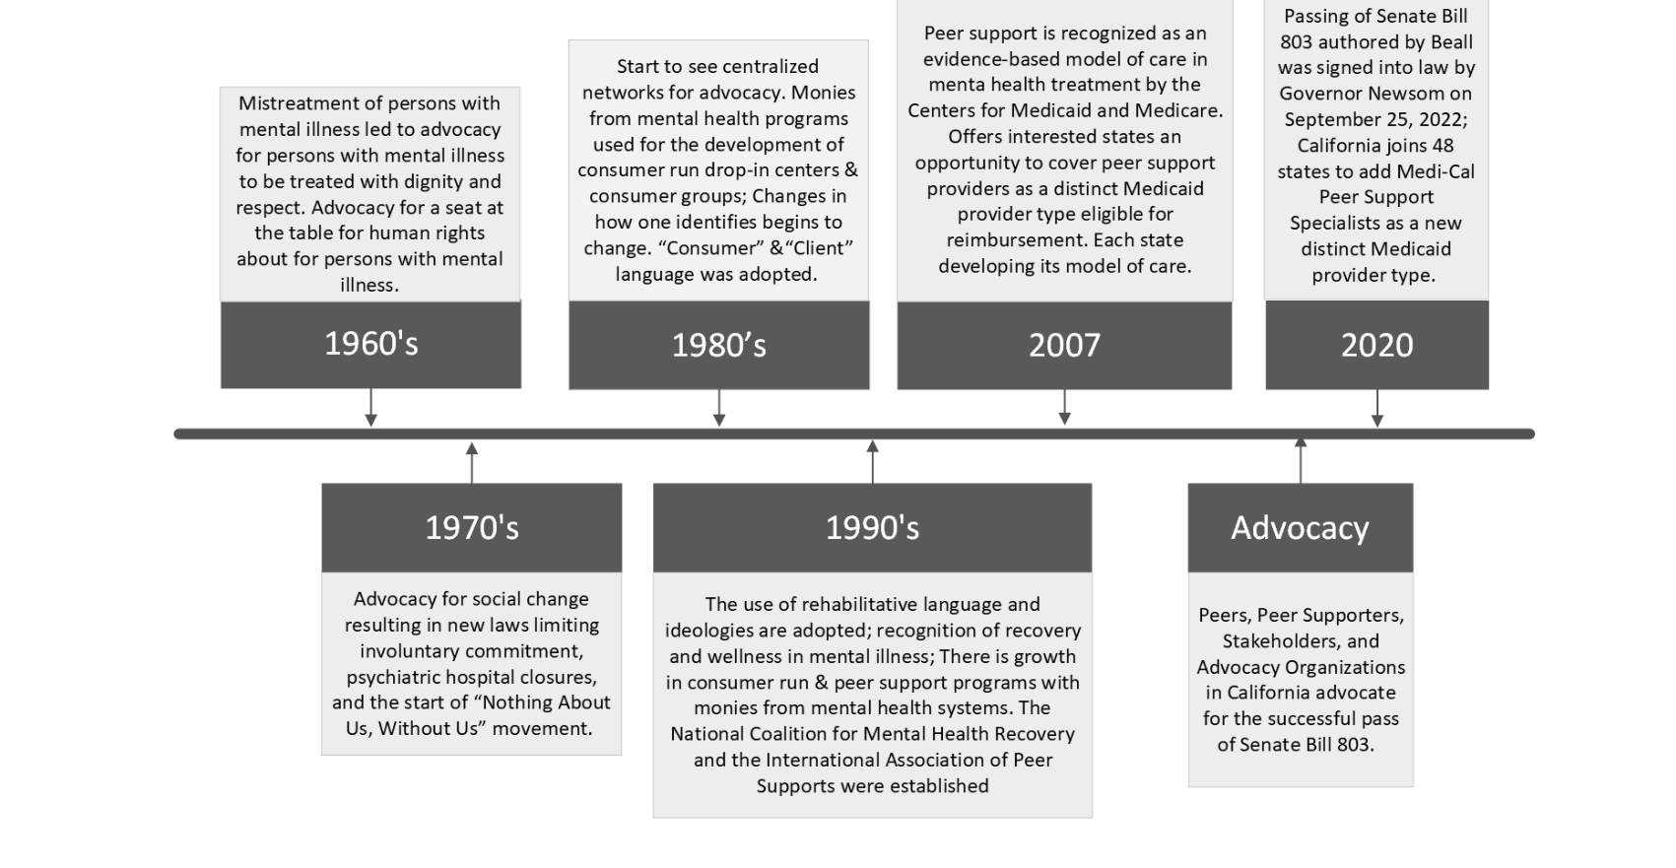
Let's start at the beginning...
Though Peer Support historically has focused on adults ages 20-50, how does Peer Support affect other parts of life?
Notes:
Quick fun fact, Peer support is actually dated as beginning in 18th century France at Bicêtre Hospital in Paris by Jean Baptiste Pussin, He was the first person on record to see the value of mutuality of experience in recovery services.
A History of Peer Support — Love and Respect (loveandrespectcommunityforrecoveryandwellness.org)

Slide 5
How Peer Support Stays Relevant

Slide 6
Peer Support is...
Flexible
Adaptable
Universal
Transformative
Notes:
Open discussion:
The earliest form of peer support can be seen in childhood. Once we turn 3, our interests shift from the self to those arounds us. (How to Support Peer Interaction in Early Childhood Settings (hanen.org))
As we develop, the need for us to be taught how to support each other in day-to-day interactions becomes less and less. On the playground you can see children helping one another play a game, solve a problem or even collaborate to solve a problem. At work you we provide support our fellow co-workers because lets face it, humans are inherently supportive of one another. I believe that we all want to see others succeed just as much as we want ourselves to succeed
Quick question, When your earliest memory you have of either providing or receiving peer support? Mine is when I was in elementary school! I used my lived experience at the school to help a new student find their way throughout the building. Peer support can be as simple and universal as that.
We're also going to be discussing how Peer support evolves throughout adulthood and what it looks like for our Older Adult population.
Peer Support is meant to evolve as we evolve, and in the next slide that is what we will explore

Slide 7
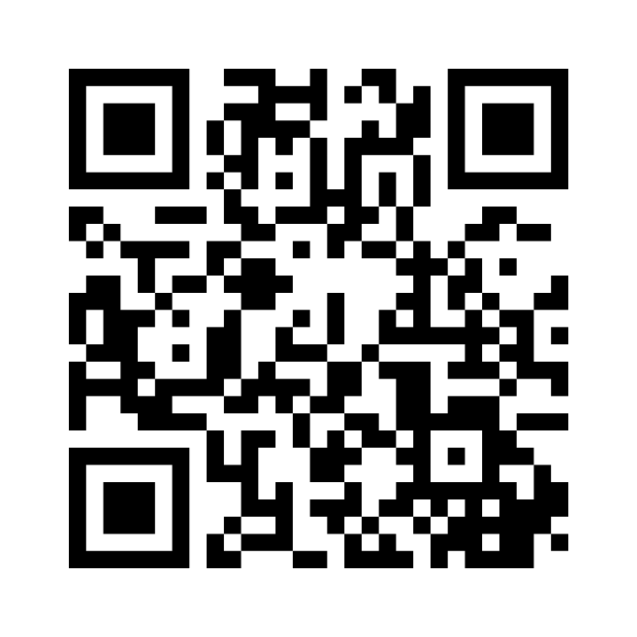
Peer Support as You Age
Think about what your needs were when you were an adolescent, are they the same as they are now?
Do you foresee them changing as you continue to age?
Scan the QR code to access the poll or use the code 5455 5902!
Notes:
Open discussion after folks answer the questions

Slide 8
Types of Peer Support
Youth Peer Advocate | Family Peer Advocate | Certified Recovery Peer Advocate | Certified Peer Specialist
Notes:
Though the application requirements may differ the fundamentals stay the same! The diversity of peer support allows specialties to be created allowing for more individualized care to be given.

Slide 9
Youth Peer Advocate
Young people have been part of the peer support movement since the beginning
Organized Youth Peer Support started in the late 1980s
Became a Medicaid billable service in 2013
Specifically for transition aged youth, under 18

Slide 10
Job expectations of a YPA
Facilitate support groups
Documentation according to agency policy
Provide mutual support through established structured, strength-based, equitable relationships based on lived experience navigating a youth serving system
Provide connections to outside community resources such as Youth clubs, recreational groups and other mental health supports etc...
Empowers families to advocate through coaching, mentoring and modeling
Notes:
YPAs are especially equipped to support other young people because their lived experience is still fresh enough to be relevant to what other young folks are currently experiencing. Its important that YPAs are within the 18-30 age because of the special relatability that they bring.
YPAs can work in clinics, RTFs, CRs, out in the community and schools

Slide 11
Family Peer Advocate
Family peer support began late 1980s
Family Peer Advocates became Medicaid billable in 1999
This service is for parents (biological, adopted or foster) of young people with behavioral and/or mental health challenges
To become an FPA you must have lived experience in navigating the system for/with your child
Notes:
You can be cross credentialed as a YPA and FPA depending on when you have children. This exists to provide support to Parents of children with behavioral and mental health challenges and often provided in conjunction with Youth Peer Support Services to provide whole family supports

Slide 12
Job expectations of a FPA
Promote needed changes in the systems that affect at-risk parents and children
Provides peer support to families
Meets documentation requirements in a timely manner based on agency policy
Empowers families to advocate for Family Driven Care through coaching, mentoring and modeling
Facilitates/co-facilitates meetings with families in the home, agency or community
Notes:
FPAs can work in school systems, nonprofit organizations, legal offices, government agencies or health care networks

Slide 13
Certified Recovery Peer Advocate
NYS Medicaid billable in 2015
Focuses on providing support to those in recovery of Substance Use Disorders based on own lived experience
In 2019, OASAS collaborated with community agencies to create 2 separate designations to add to the CRPA; CRPA-Y and CRPA-F
These designations differ by type of lived experience...
Notes:
CRPA lived experience is FIRST HAND living and navigating the world with substance misuse
CRPA-Y lived experience is SECOND HAND supporting parents/ caregivers with SUD OR first hand with SUD
CRPA-F is lived experience RAISING a child or being a legal caregiver of someone with SUD
In order to get either of these specialties you MUST have completed the initial CRPA training and hold a PROFESSIONAL credential

Slide 14
Job expectations of a CRPA
Educating program participants about various modes of recovery while encouraging them to find what works FOR THEM
Raising awareness of existing social and other support services
Linking participants to formal recovery supports
Assisting with applying for benefits, going to medical appointments and other things as needed that are specified by the agency of employment
Notes:
CRPAs can work in non-profit community based programming, clinics, hospital detox's and more. CRPA-Y/F can also work in school designations as prevention supports. CRPAs implement many strategies to encourage whole person wellness and ultimately support the individual in discovering what is right for them. CRPA-Y/F support those family members in forming coping skills and strategies for support for the individuals.

Slide 15
Certified Peer Specialist
Began in the 70s but was seen as early as the late 1800s in Europe
Became Medicaid billable as early as 2001
Focuses on supporting those with Mental Health diagnosis maintain wellness; however it manifests to them
Notes:
Certified Peers can work in community programs, hospitals, housing and so much more. Lived experience is a vague thing and the way in which ones experiences develop can play a part into what type of setting they choose to work in.
Quick side note; The NYCPS is offering many specialty tracks for people taking their training, and these tracks expand the ways in which Certified Peer Specialists are utilized in the workforce.

Slide 16
Job Expectations of a Certified Peer Specialist
Act as a role model for clients to prove mental health recovery is possible
Discuss shared lived experiences in a constructive/ supportive way
Identify client needs and develop a recovery plan for those needs
Teach and encourage clients to practice self-advocacy
Connect clients with community support and resources

Slide 17
What's next?

Slide 18
Peer Support for Older Adults
Why have the specialty?
What would it even look like?
What programs, if any are already out there?
Notes:
PowerPoint Presentation (mhanational.org)

Slide 19
Programs currently out!
Pennsylvania has COAPS or Certified Older Adult Peer Specialists which trains folks to navigate what wellness means as you age
Broward County, FL has created Silver Inc, which provides peer support outreach
NYS Office for the Aging--> Senior Companion Program; folks ages 55+ can work with older adults on various non-clinical needs
The Academy of Peer Services, which conducts the NYCPS training has a specialty track for Older Adult Peers
Notes:
=

Slide 20
Why have the specialty?
as of 2024, approximately 19% of the world's population is over 65 years old
Across the board people are living longer, which also means people with mental health challenges are also living longer.
MHA conducted a study which found that most geriatric health teams do not include mental health services
As the population ages the comprehensiveness of service provision needs increase!
Notes:
Age Structure by Country 2024 (worldpopulationreview.com)

Slide 21
Remember... Collaboration is Key
Youth Peer Support
Family Peer Support
Peer Support
Certified Peer Specialist
Certifed Recovery Peer Advocate
Peer Support movement
Notes:
We all play a part in the success of peer advocacy regardless of lived experience or part of life we are in. The peer support movement is larger than anyone one person, evolving along side and sometimes past what we personally are going through. Peer support, by definition is meant to continually grow and we as peer support workers are fortunate enough to be in a profession that allows us to grow along with it.

